Slide 1

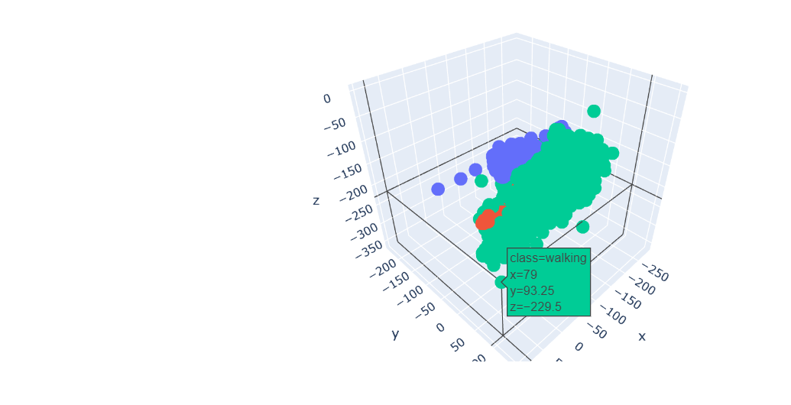
Human Activity
Recognition
Accelerometer Data Analysis
Shirisha Biyyala (CJ85694)

Slide 2
INTRODUCTION
1
2
3
4
Personal activity monitor similar to BodyMedia and Fitbit
Potential applications in health, fitness, and well-being.
Wearable device leveraging accelerometer data.
understanding human behavior to advancements in psychology and sociology
Why Human Activity Recognition
is important?

Slide 3
OBJECTIVES
One
Two
Detect the activity of an individual from accelerometer data.
01
02
Derive features exploiting temporal data.
Four
Three
Identify the optimal machine learning model for classification accuracy.
04
03
Investigate change-point detection.

Slide 4
Dataset Overview
—--
8 hours of accelerometer data for 4 individuals: Debora, Jose Carlos, Katia, Wallace
Sensor 3
—--
Sensor 1
3-axis measurements from accelerometers on waist, left thigh, right arm, and right ankle.
Sensor 2
—--
5 activity classes: sitting, sitting-down, standing, standing-up, walking.
Sensor 4

Slide 5
Data Preprocessing
Sensor Data
Outliers handling
Feature Engineering
Feature Scaling
Accelerometer data
Outlier transformation - median imputation
One-hot coding
Label Encoding
Standardization

Slide 6
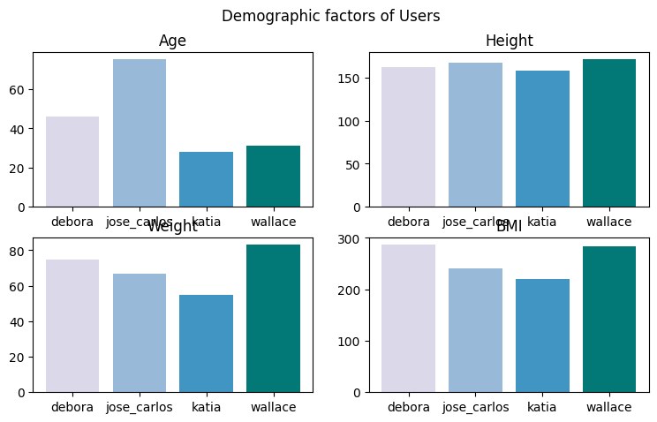

Slide 7
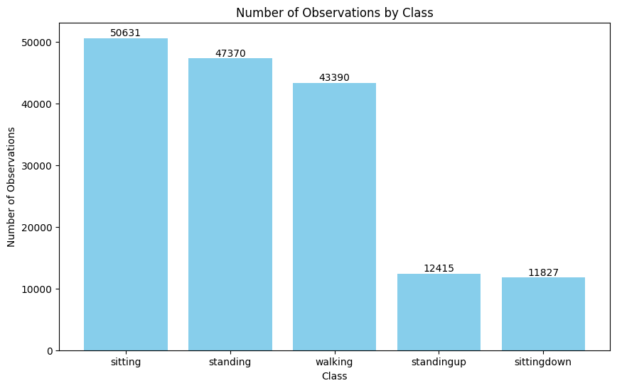
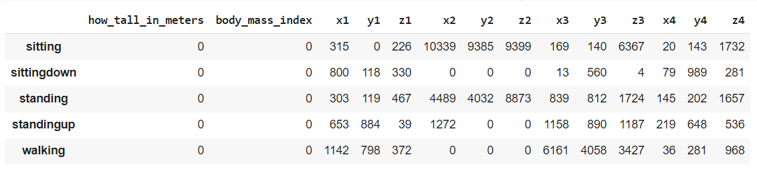

Slide 8
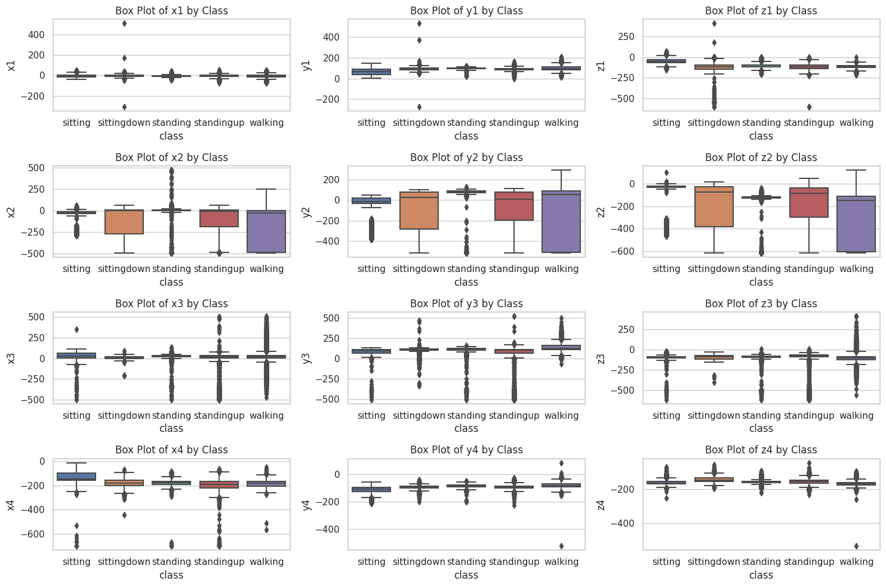
Outliers through Box plots
Sensor 1
Sensor 2
Sensor 3
Sensor 4

Slide 9
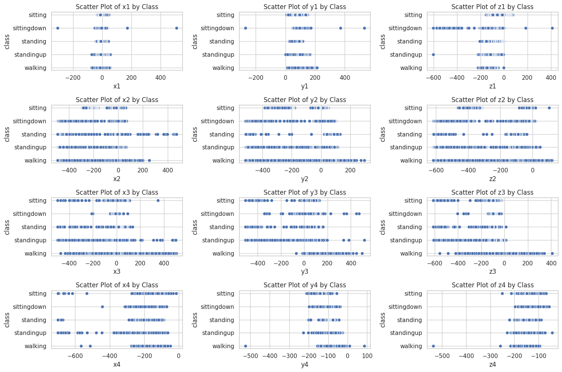
Outliers through Scatter plots

Slide 10
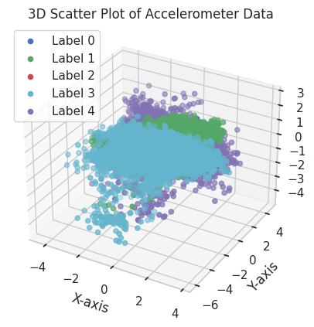

Slide 11
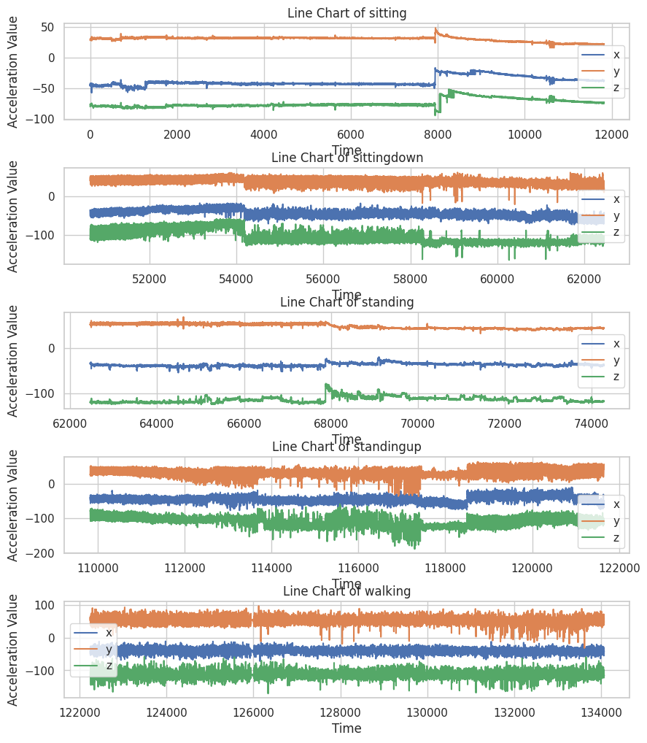
INFERENCE
The line graphs suggest that people spend most of their time sitting, with some standing and walking throughout the day. There are cyclical patterns in the data, with peaks and valleys occurring at regular intervals. There are also some outliers in the data, suggesting that some people are more active than others.

Slide 12
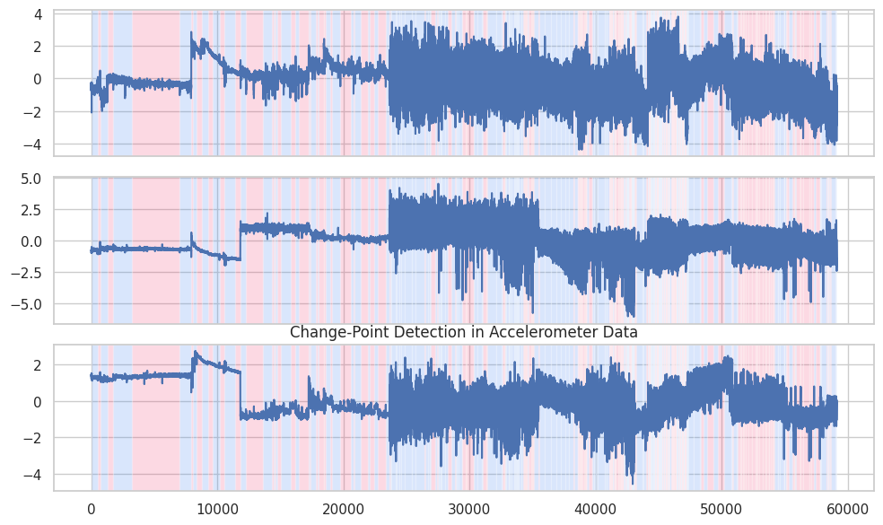

Slide 13
Machine Learning Models
Model | Accuracy
Logistic Regression | 0.5476
Naive Bayes | 0.6364
Decision Tree | 0.7317
SVM | 0.7599
Random Forest | 0.7887
AdaBoost | 0.5125
Gradient Boosting | 0.7854
Neural Network (MLP) | 0.7881

Slide 14
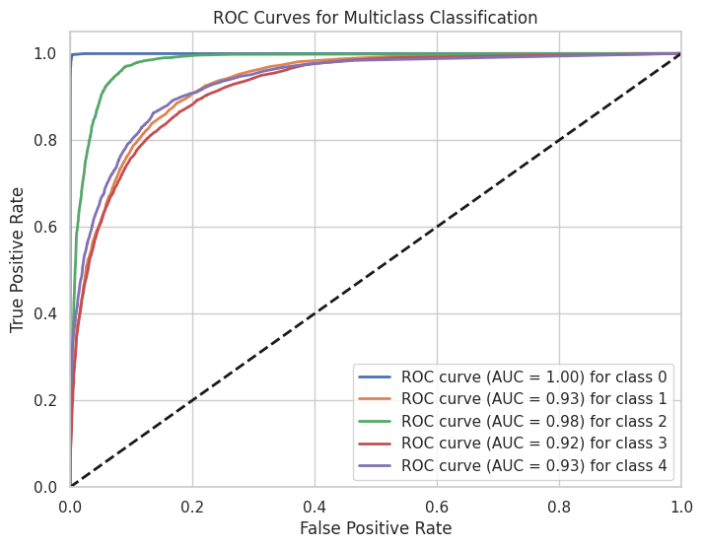

Slide 15
Hyperparameter Tuning
Best Hyperparameters:
{'max_depth': 18, 'max_features': 'sqrt', 'min_samples_leaf': 4, 'min_samples_split': 14, 'n_estimators': 120}
Random Forest Accuracy: 0.8097573349116428
Classification Report:
precision recall f1-score support
0 0.99 0.99 0.99 2382
1 0.75 0.70 0.72 2427
2 0.82 0.90 0.86 2314
3 0.73 0.70 0.71 2320
4 0.75 0.75 0.75 2384
accuracy 0.81 11827
macro avg 0.81 0.81 0.81 11827
weighted avg 0.81 0.81 0.81 11827

Slide 16
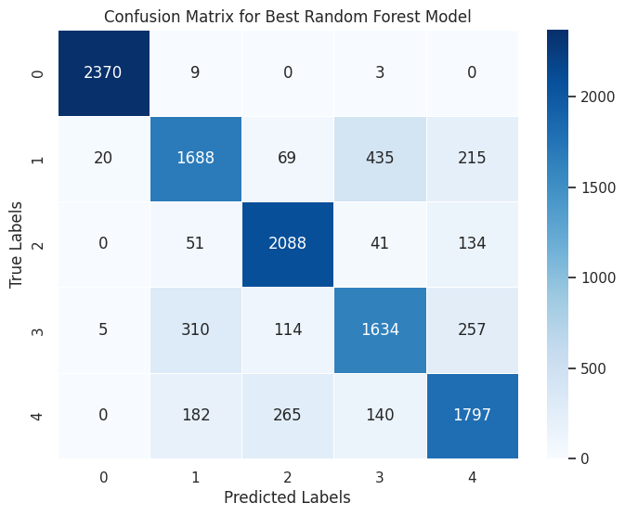
Best Random Forest Model Accuracy: 0.8098
Recall: 0.8098
Precision: 0.8080
F1 Score: 0.8083

Slide 17
Conclusion
The project explores and implements various strategies for human activity recognition, considering the temporal aspects of accelerometer data, change-point detection. The Random Forest Classifier stands out as the most accurate model, providing valuable insights for the development of personal activity monitors.
It's essential to consider not only accuracy but also other metrics such as precision, recall, and F1-score, especially if the dataset is imbalanced or if certain misclassifications have higher consequences than others. Additionally, further exploration and optimization of hyperparameters could potentially improve the performance of the models.

Slide 18
Data Risk
Limitations
Risk
Support
Model Risk
Interpretation Risk
Data noise, limited variability in the dataset, potential overfitting.
Collaboration with domain experts for feature engineering, and assistance with obtaining additional diverse datasets.
Difficult to analyze the sequence of activities without the temporal information
Combining data from multiple sensors can provide a more comprehensive picture of the movement and improve the accuracy

Slide 19
Recommendations
Collaborating with Domain Experts
Addressing Data Noise and Limited Variability
Handling Temporal Information
Leveraging Data from Multiple Sensors

Slide 20
Human Activity Recognition
01
Integrate the project and presentation into a webpage.
02
Implement CNN and RNN for in-deep insights.
Future Work
03
Identify change-points without reliance on timestamps.
04
Enhance my research through valuable feedback from peers.

Slide 21
Thank you

